Slide 1
UMKC PARKING APP
Gregory Brown
(Class ID: 5)
Pravalhika Kampally
(Class ID: 22)
Muhammad Ali
(Class ID: 61)

Slide 2
INTRODUCTION
Major U.S. cities and a new wave of startups are working to simplify the parking process, perhaps marking a revolution in the parking industry.
Our main idea is to present an app which the user can receive updated information as well as update the lot availability to the app which helps the other parkers before they park.

Slide 3
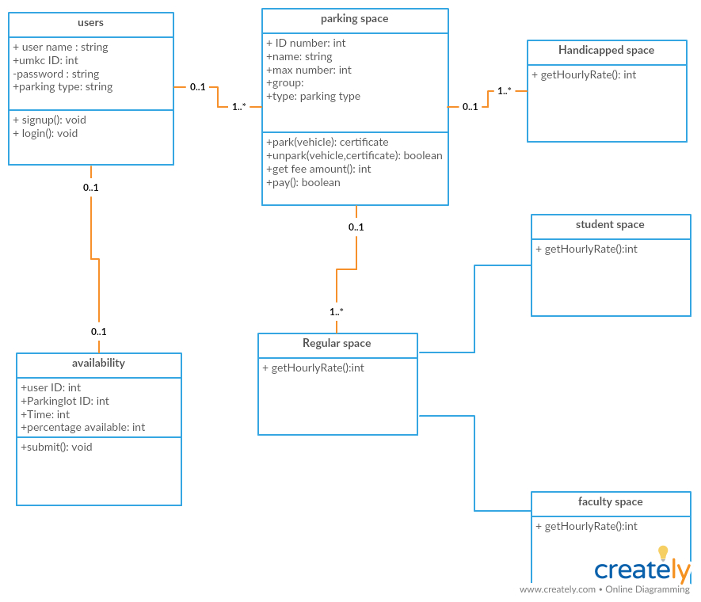
CLASS DIAGRAM

Slide 4
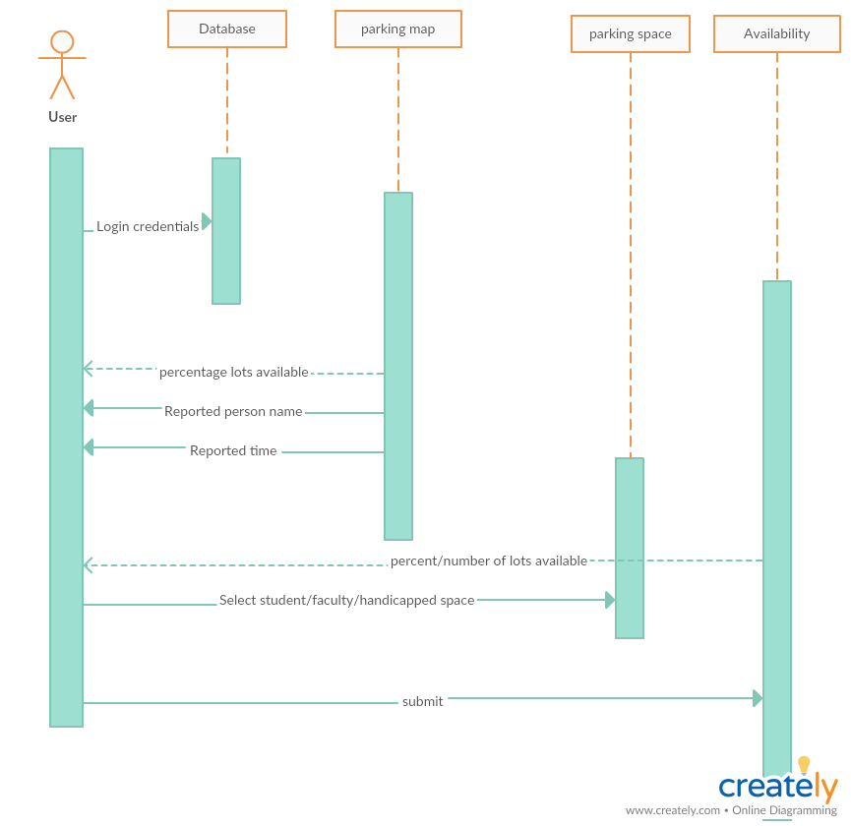
SEQUENCE DIAGRAM

Slide 5
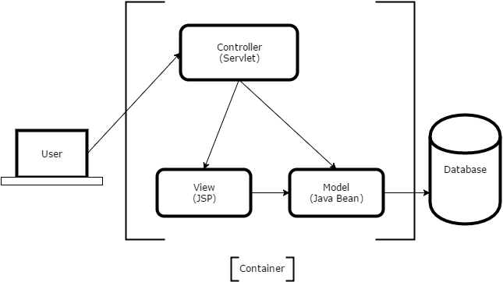
ARCHITECTURE

Slide 6
TECHNOLOGIES USED
Html
Angular JS
Css
Node js with express for server
Mean Stack
Google Maps and Places API
Node Red flow

Slide 7
Continued…
HTML: It stands for Hyper Text Markup Language. Used for creating Webpages.
AngularJS : It is a structural framework for dynamic web apps.
CSS(Cascading Style Sheets): It is a style sheet language used for describing the presentation of a document written in a markup language like HTML.

Slide 8
MEAN STACK
MongoDB : Document database – used by your back-end application to store its data as JSON (JavaScript Object Notation) documents
Express: (sometimes referred to as Express.js): Back-end web application framework running on top of Node.js
Angular: (formerly Angular.js): Front-end web app framework; runs your JavaScript code in the user’s browser, allowing your application UI to be dynamic
Node.js : JavaScript runtime environment – lets you implement your application back-end in JavaScript

Slide 9
OUTPUT

